Slide 1

ICBP 2.0
Smart AI Nutrition Assistant
Your Name : Shashank Shekhar
Project GitHub Link: https://github.com/shashank-learning/ICBP.git

Slide 2
Content
Problem Statement
Objective
Model Used
Flow Chat
Architecture Overview
Prompt Engineering
Technologies & Library Used
Results
Conclusion & Future Work
References

Slide 3
Problem Statement
In the current landscape of nutrition and dietary guidance, individuals often encounter several challenges that hinder their ability to achieve optimal health through personalized nutrition. Existing tools typically offer generic diet plans that do not account for the unique needs of each individual. These limitations include:
Lack of Personalization - Most diet plans are one-size-fits-all, failing to consider individual factors such as cultural preferences, allergies, and specific health conditions.
Inflexibility - Current solutions do not adapt in real-time to changes in a user's lifestyle, preferences, or health status, leading to outdated or irrelevant recommendations.
Resource Constraints - Nutritionists and dieticians are often unable to provide personalized consultations at scale due to time and resource limitations, leaving many individuals without access to tailored guidance.
Limited Interaction - Existing tools may not effectively engage users through various modalities (text, voice, or images), which can enhance the user experience and improve understanding.

Slide 4
Objective
The objective of this project is to develop "The Smartest AI Nutrition Assistant," an intelligent, interactive, and adaptive virtual nutrition assistant that leverages generative AI technologies to address the aforementioned challenges.
Understand User Inputs
Generate Personalized Meal Plans
Provide dietary explanations
By integrating health data, comprehensive food databases, and large language model (LLM)-powered reasoning, this solution aims to bridge the gap between generic diet applications and personalized nutrition counseling. Ultimately, the goal is to deliver an AI that not only thinks and learns but also demonstrates care and understanding akin to a real nutrition expert, empowering individuals to make informed dietary choices for better health outcomes.

Slide 5
Model Used
Large Language Models - Large language models (LLMs) are a category of foundation models trained on immense amounts of data making them capable of understanding and generating natural language and other types of content to perform a wide range of tasks.
Google Gemini Model:
Specifically, gemini-2.0-flash from google.generativeai is used to:
Analyse food images and estimate calories.
Generate customized nutrition/diet plans.

Slide 6
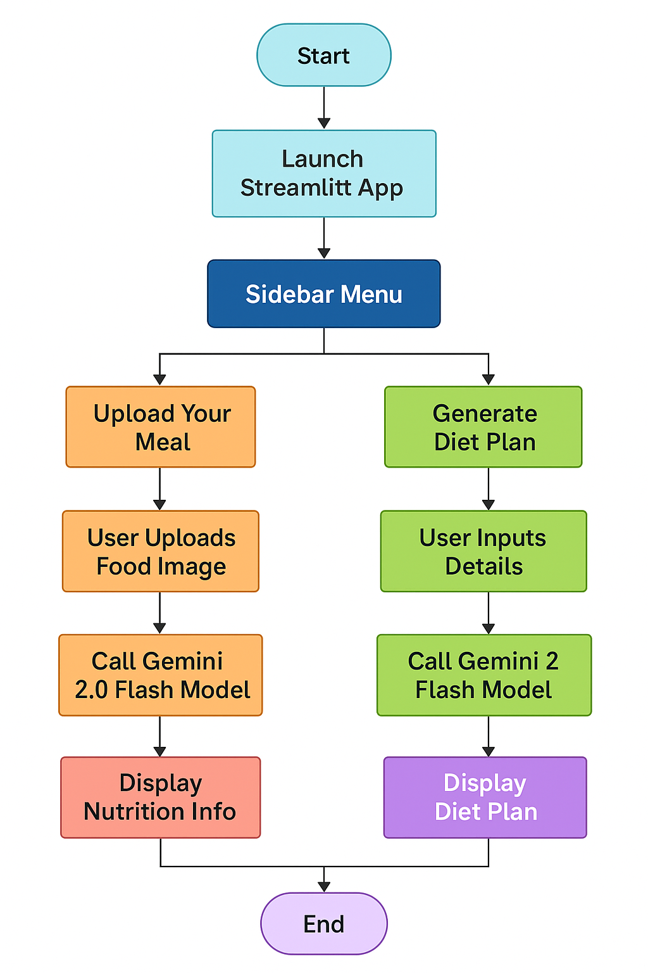
Flow Chart
Fig. 1 Smart AI Nutrition Assistant Flow Chart

Slide 7
Architecture Overview
Streamlit UI
Handles user interaction — users upload food images or enter details like age, diet type, etc., via an intuitive web interface.
Gemini API (via Google Generative AI SDK)
Processes the input using the gemini-2.0-flash model.
For images: Identifies food items and estimates calories.
For text: Generates a personalized diet plan based on user inputs.
Response Display
Outputs the results (calorie breakdown or diet plan) back to the user in a readable format within the Streamlit app.

Slide 8
Prompt Engineering
Image Based Calorie Estimation
Role instruction: Helps the model understand the context and expected behavior.
Clear structure: Specifies a numbered list format to ensure organized output.
Multitask instruction: Asks for calorie count, health analysis, and nutrient breakdown in one response.
Plain English language: Increases the likelihood of accurate interpretation by the model.
Text Based Diet Plan Generation
Personalized details: Age, gender, height, weight, allergies—makes response highly relevant.
Constraints added: Budget, dislikes, meal variety help guide the model’s creativity within realistic limits.
Instructional tone - “Please generate a detailed and personalized...” clearly instructs the model.

Slide 9
Technologies & Library Used
streamlit: Web app interface
google.generativeai: To access Gemini models
dotenv: To securely load API key
streamlit_option_menu: Sidebar menu navigation
PIL: To process image uploads

Slide 10
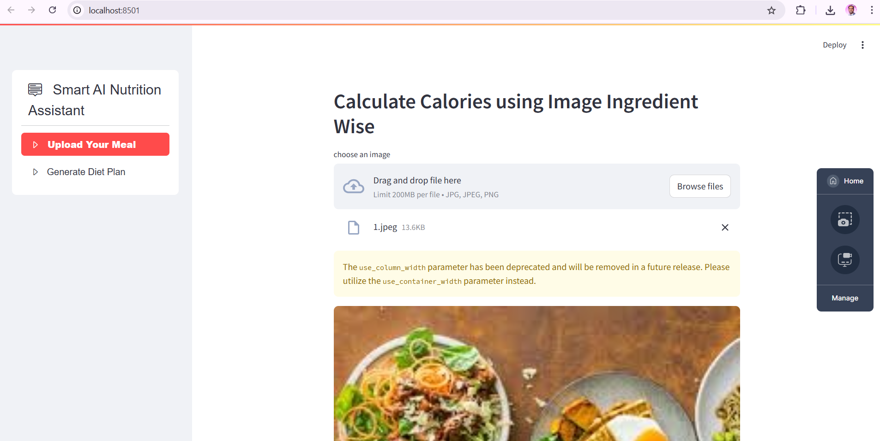
Results
Fig. 2 Calculate Calories using Image Ingredient Wise

Slide 11
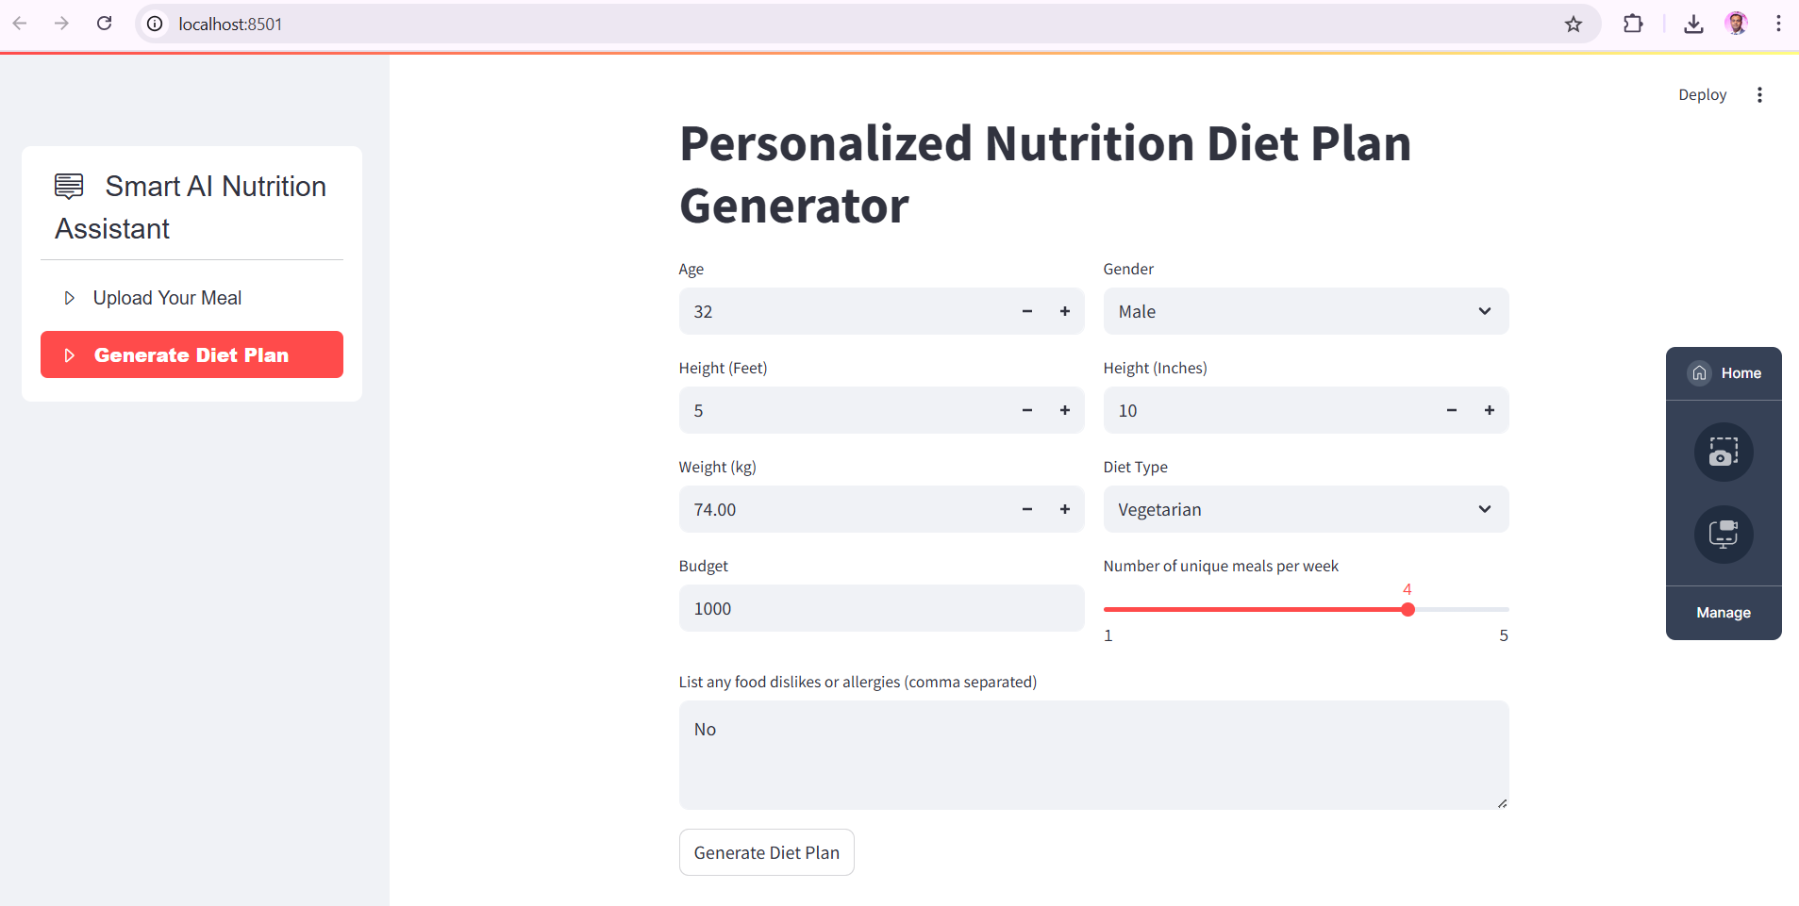
Results
Fig. 3 Personalized Nutrition Diet Plan

Slide 12
Conclusion & Future Work
The Smart AI Nutrition Assistant app effectively combines Streamlit's interactive UI with the Gemini 2.0 Flash model to deliver two key features:
Image-based Calorie Estimation: Users can upload meal images, and the app intelligently identifies food items, estimates their calorie count, and analyzes their nutritional value.
Text-based Diet Plan Generation: Based on user inputs like age, height, weight, and preferences, the app generates a personalized weekly diet plan tailored to the user’s needs.
Future Scope
The application can be enhanced in the future by integrating advanced food detection models for more accurate calorie estimation, adding user authentication and meal history tracking, supporting multilingual interactions, syncing with fitness devices for dynamic diet adjustments, and offering goal-based personalized meal plans along with grocery list generation for better user convenience and health management.

Slide 13
References
1. Streamlit - Official Documentation - https://docs.streamlit.io/
2. Google Generative AI (Gemini) https://ai.google.dev
3. Python dotenv - https://pypi.org/project/python-dotenv
4. Pillow (PIL) - Python Imaging Library - https://pillow.readthedocs.io/en/stable/

Slide 14
Thank You

